Slide 1
Solving the puzzle: A Presentation on the Sudoku Solver Project
The Interactive journey through the complex world of Sudoku Solving !
By :-
SHUBHKARMAN SINGH (102103170)

Slide 2
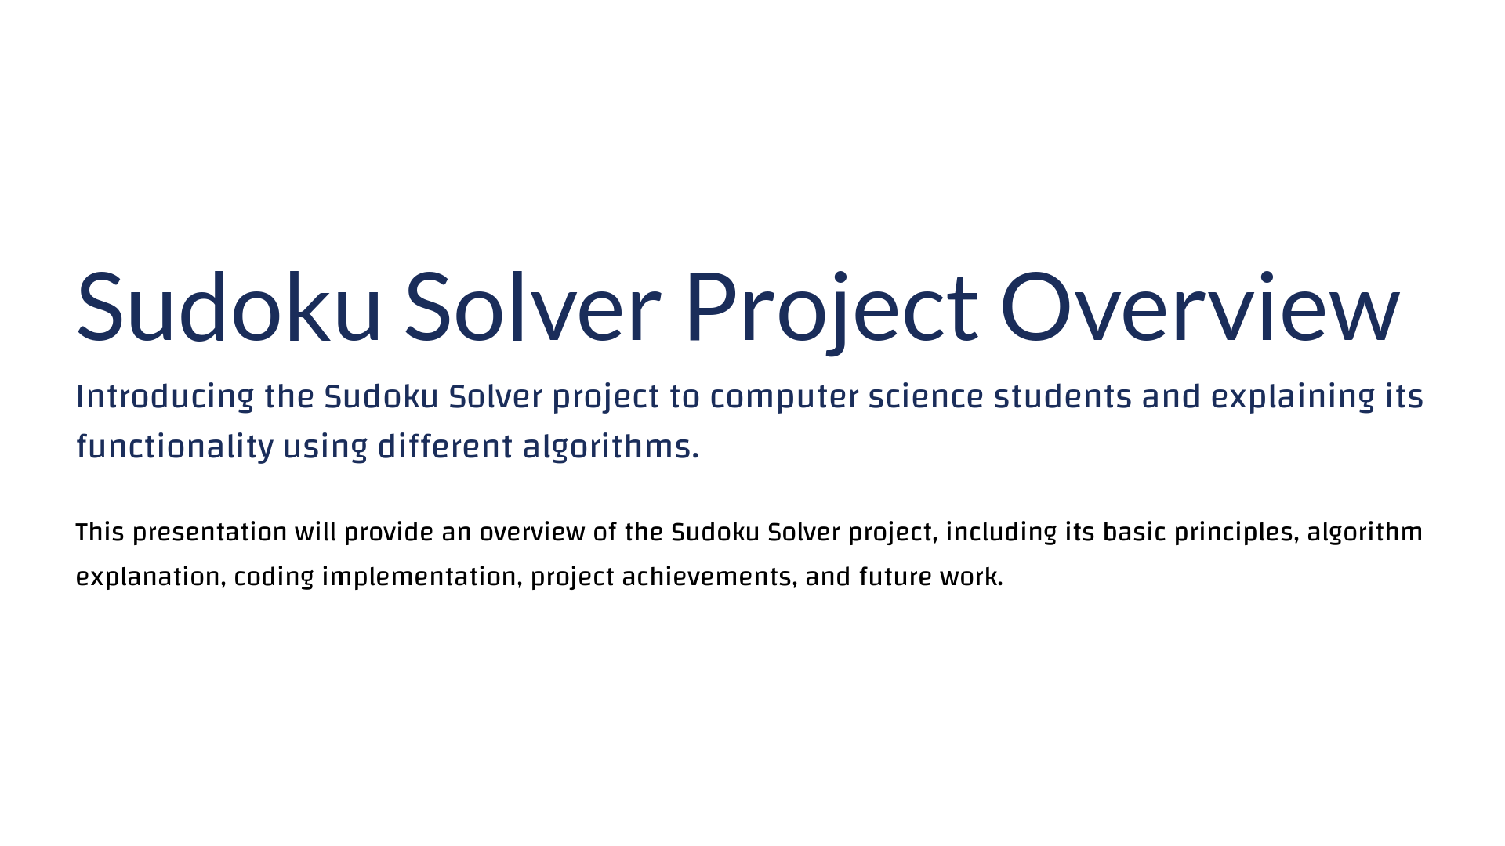

Slide 3
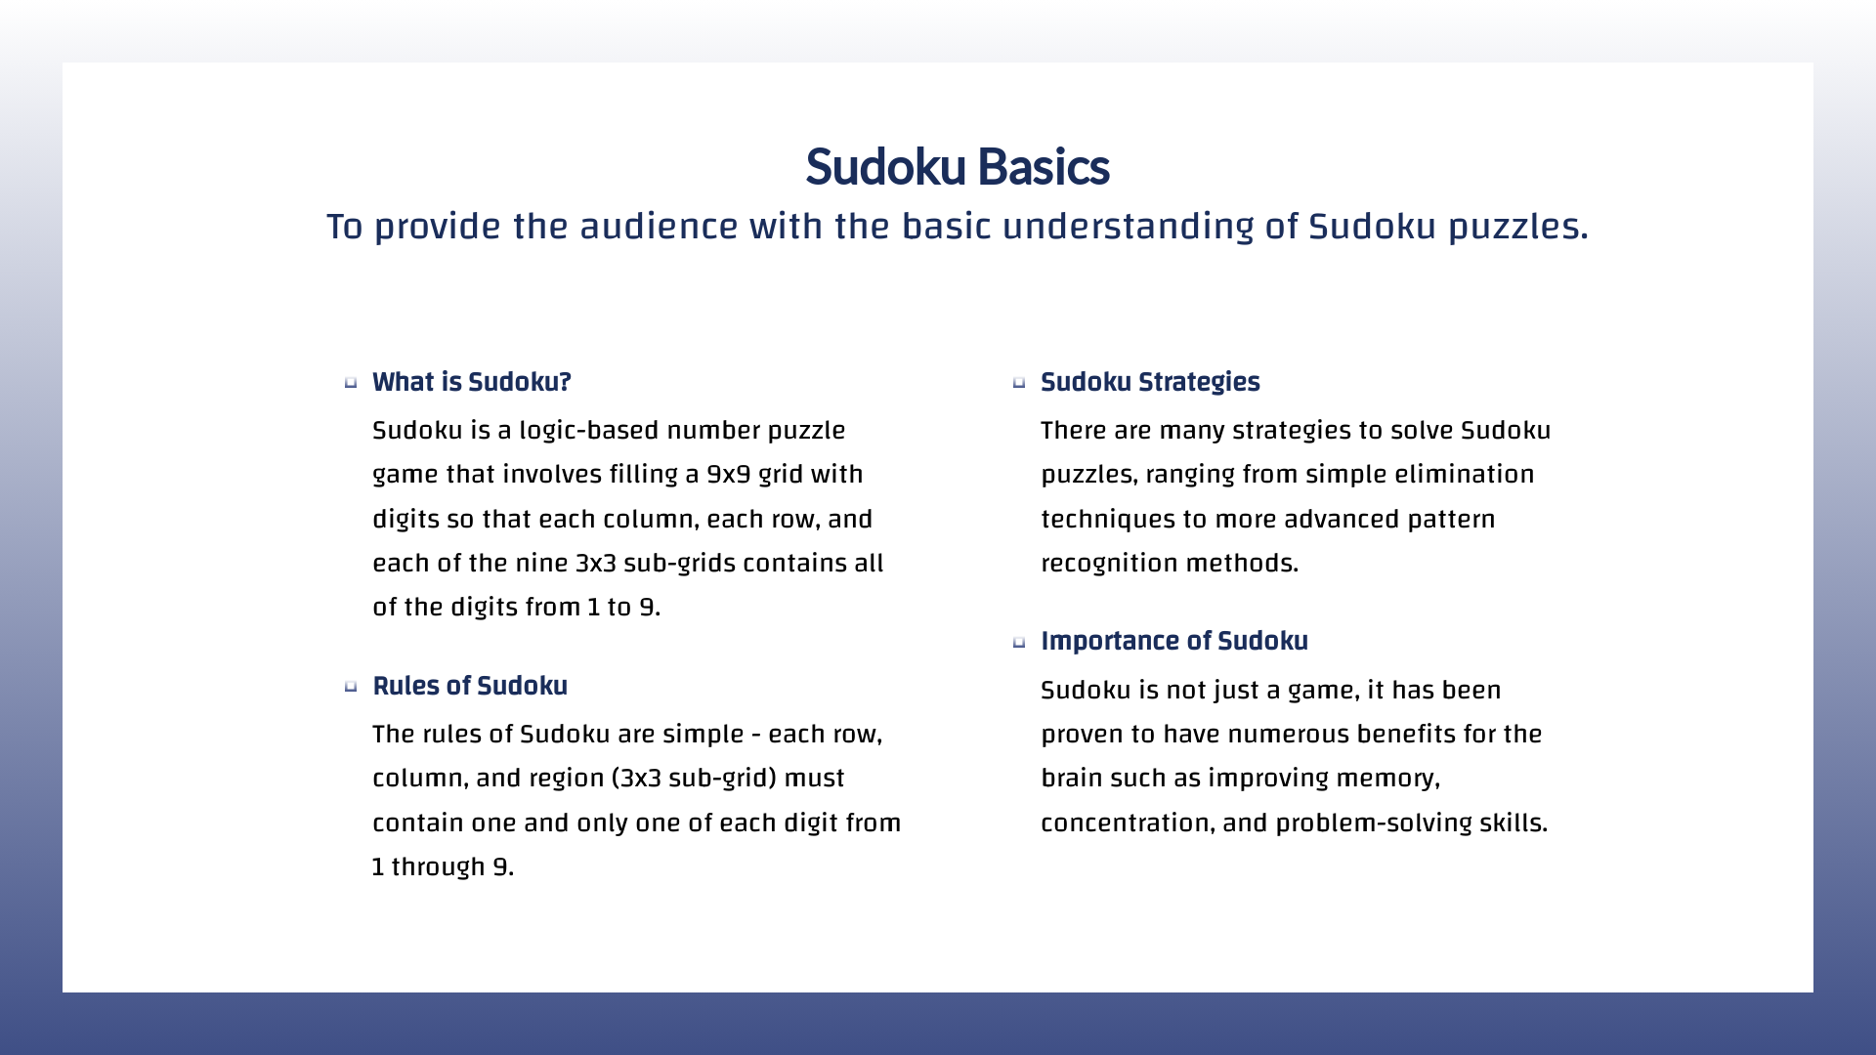

Slide 4


Slide 5
Coding Implementation
Code used in sudoku solver project
A* Algorithm uses heuristic function to solve puzzle using priority queue
DFS Algorithm it explores the search space by going as deep as possible for solution
User Interface allows user to input and display sudoku puzzle

Slide 6
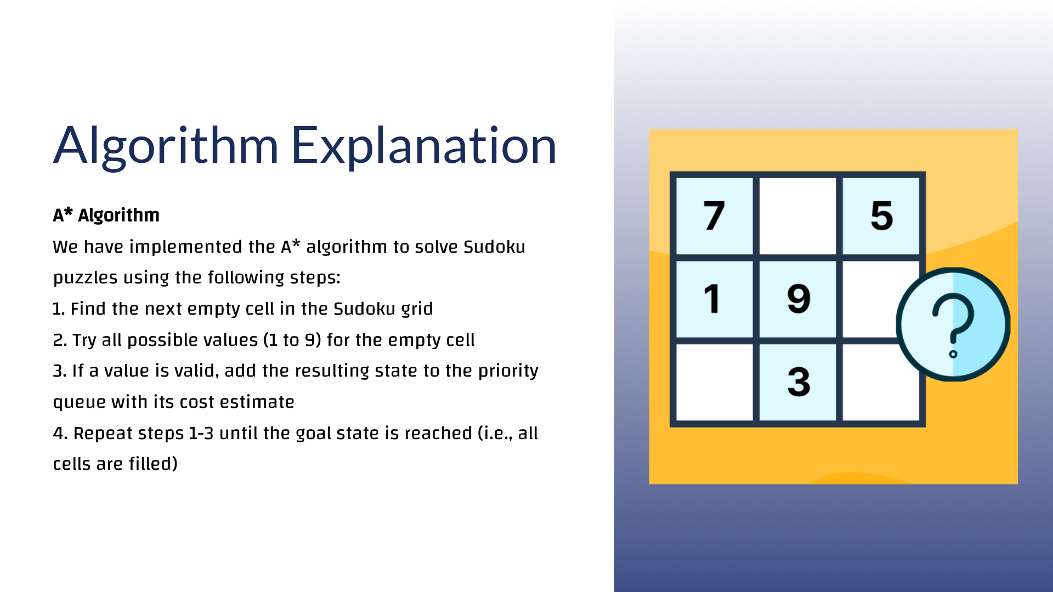

Slide 7
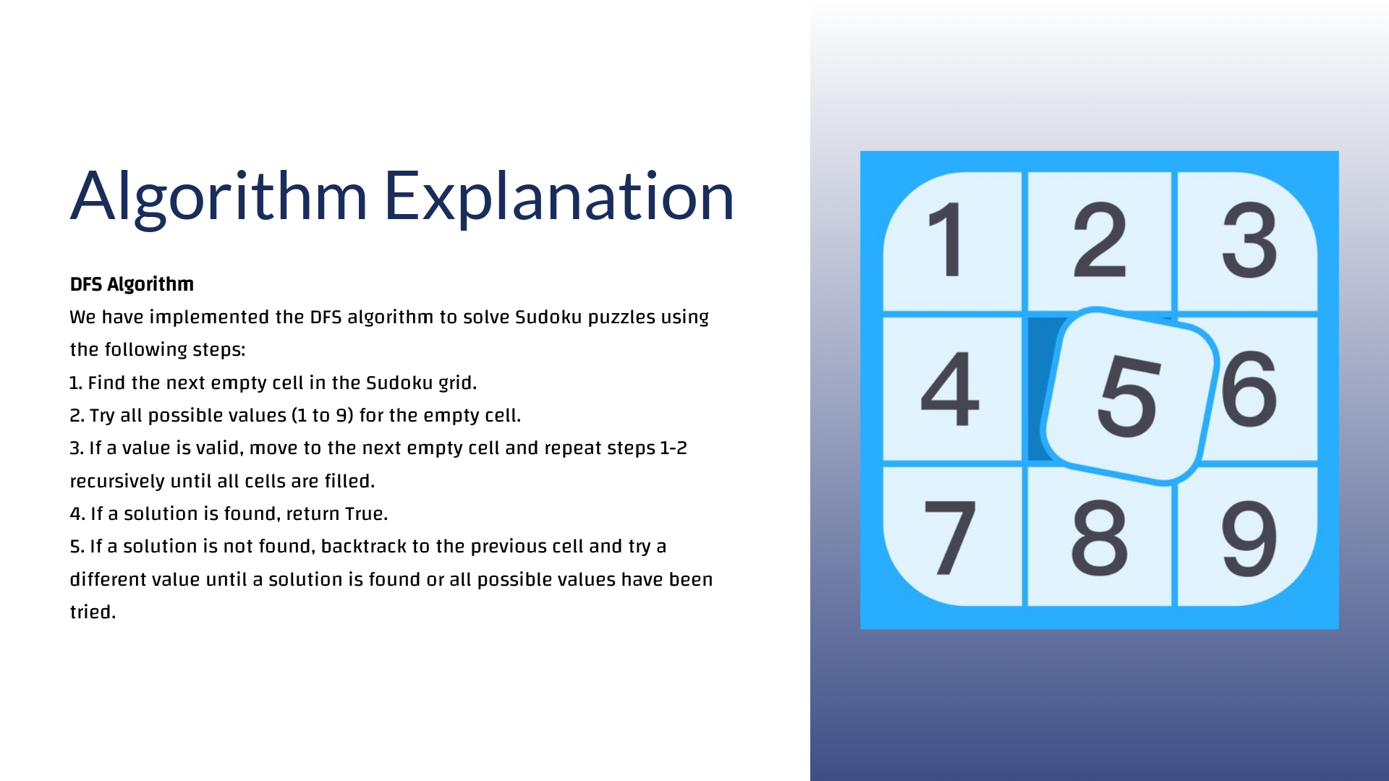

Slide 8
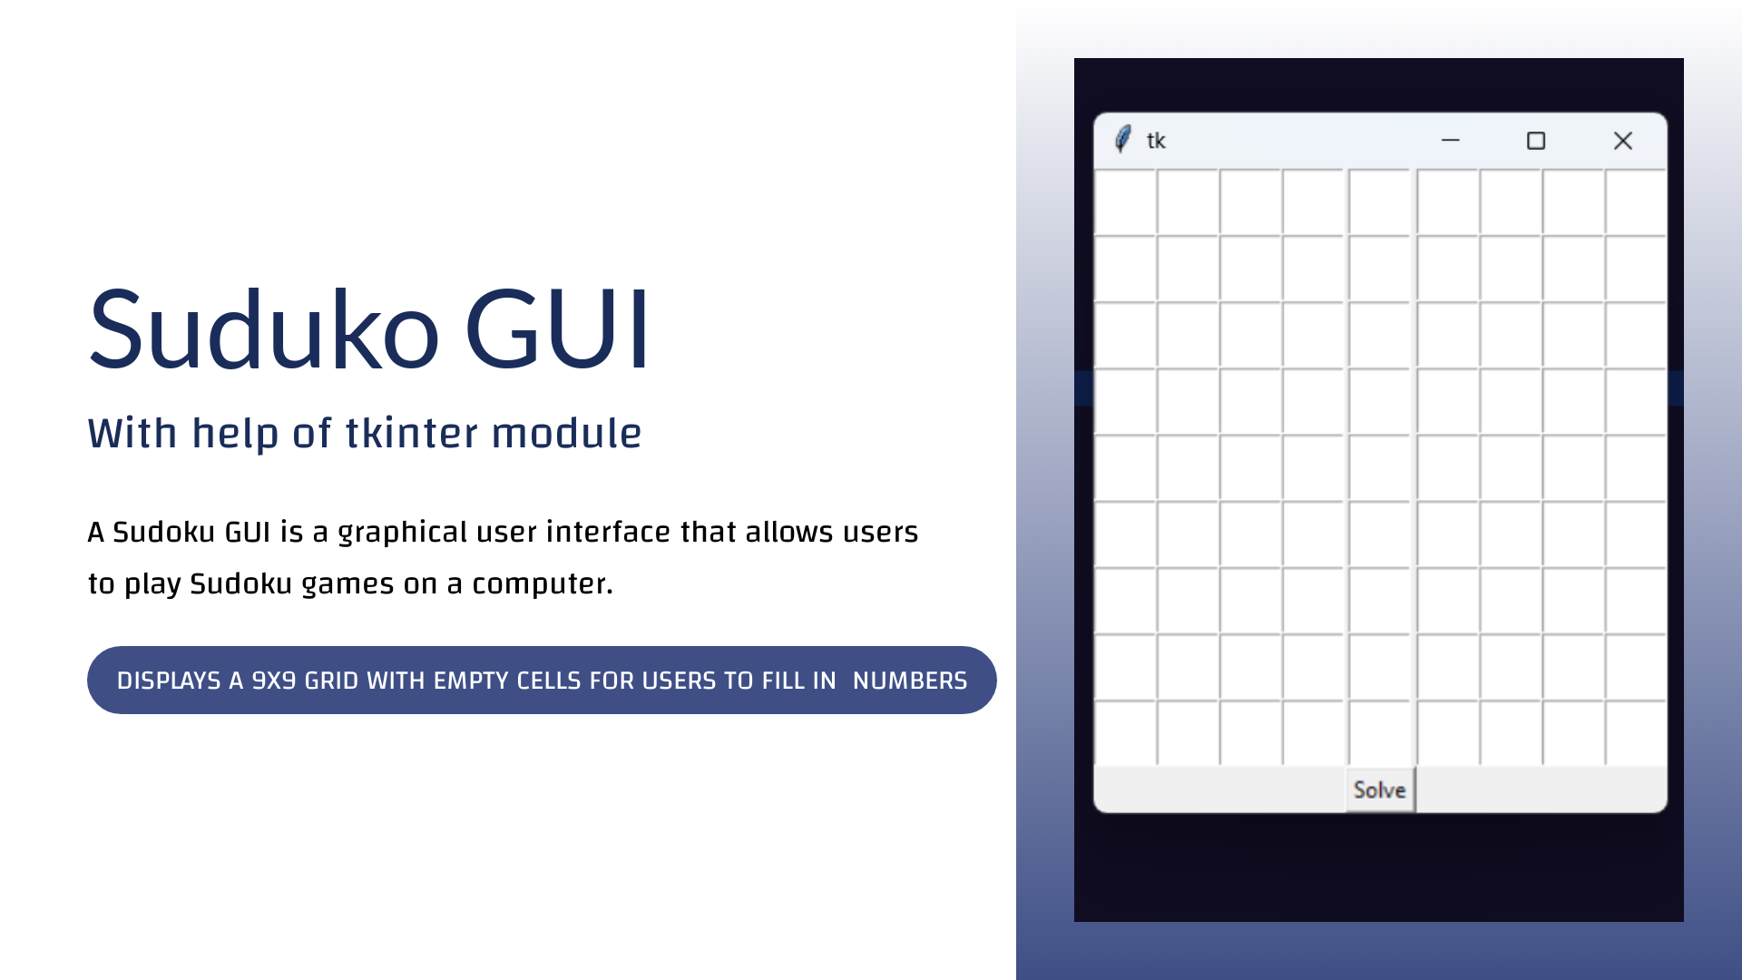

Slide 9
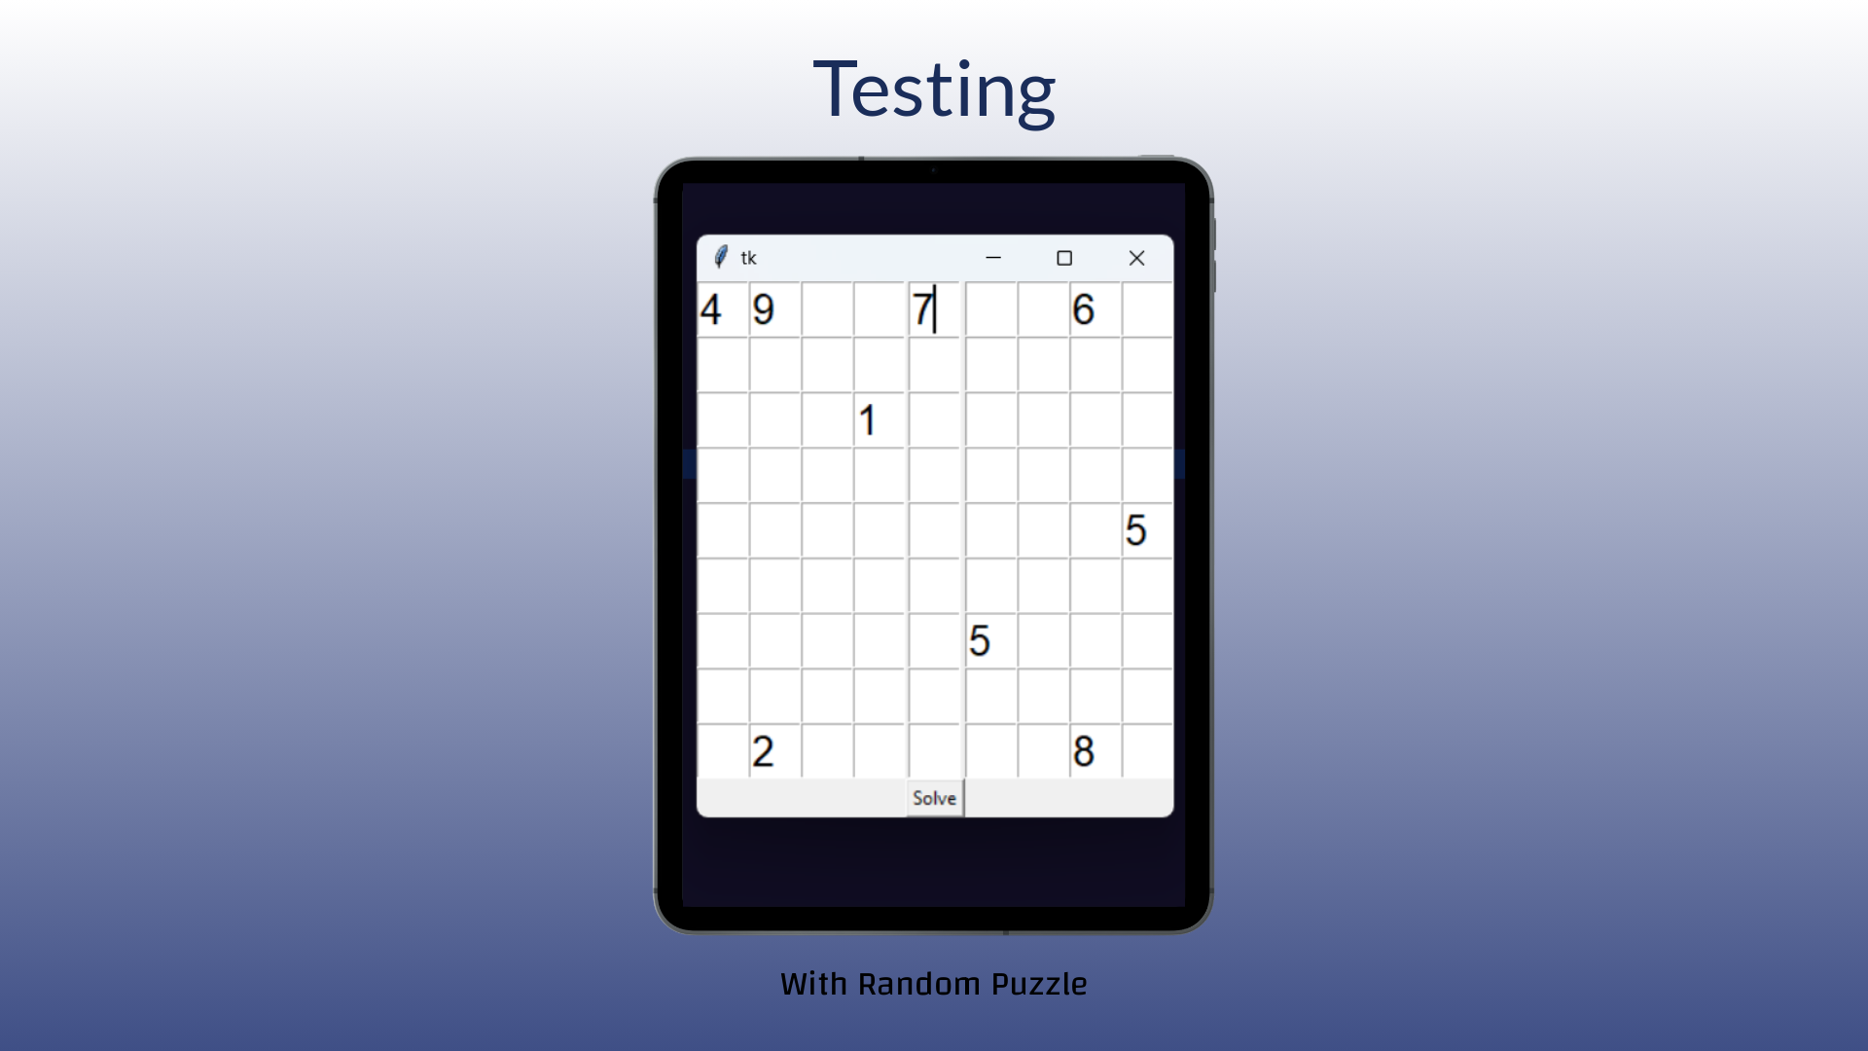

Slide 10
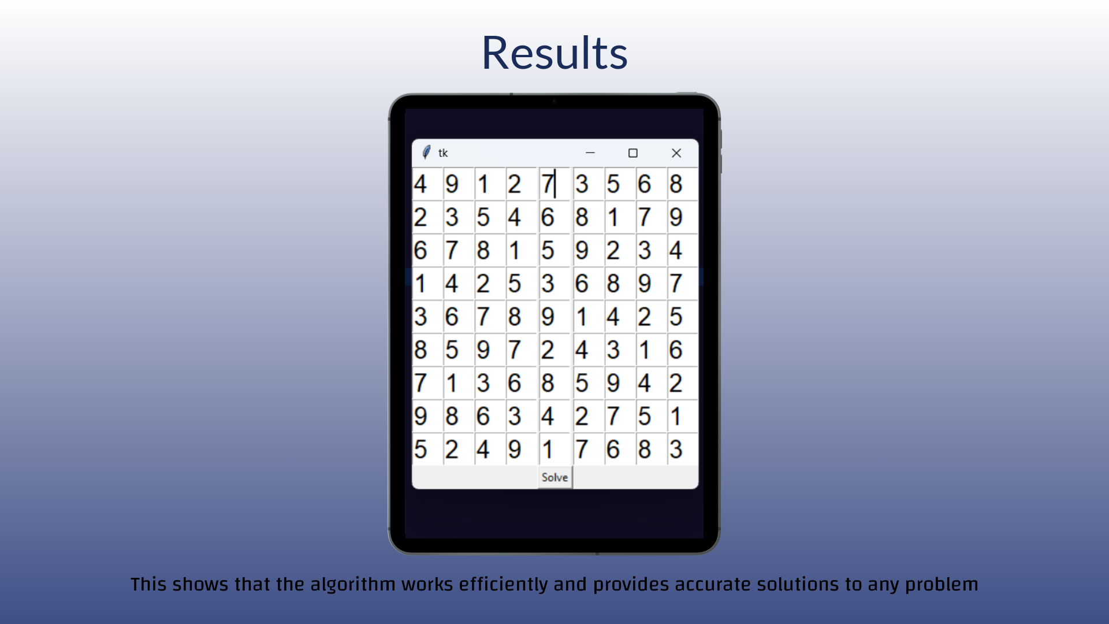

Slide 11


Slide 12
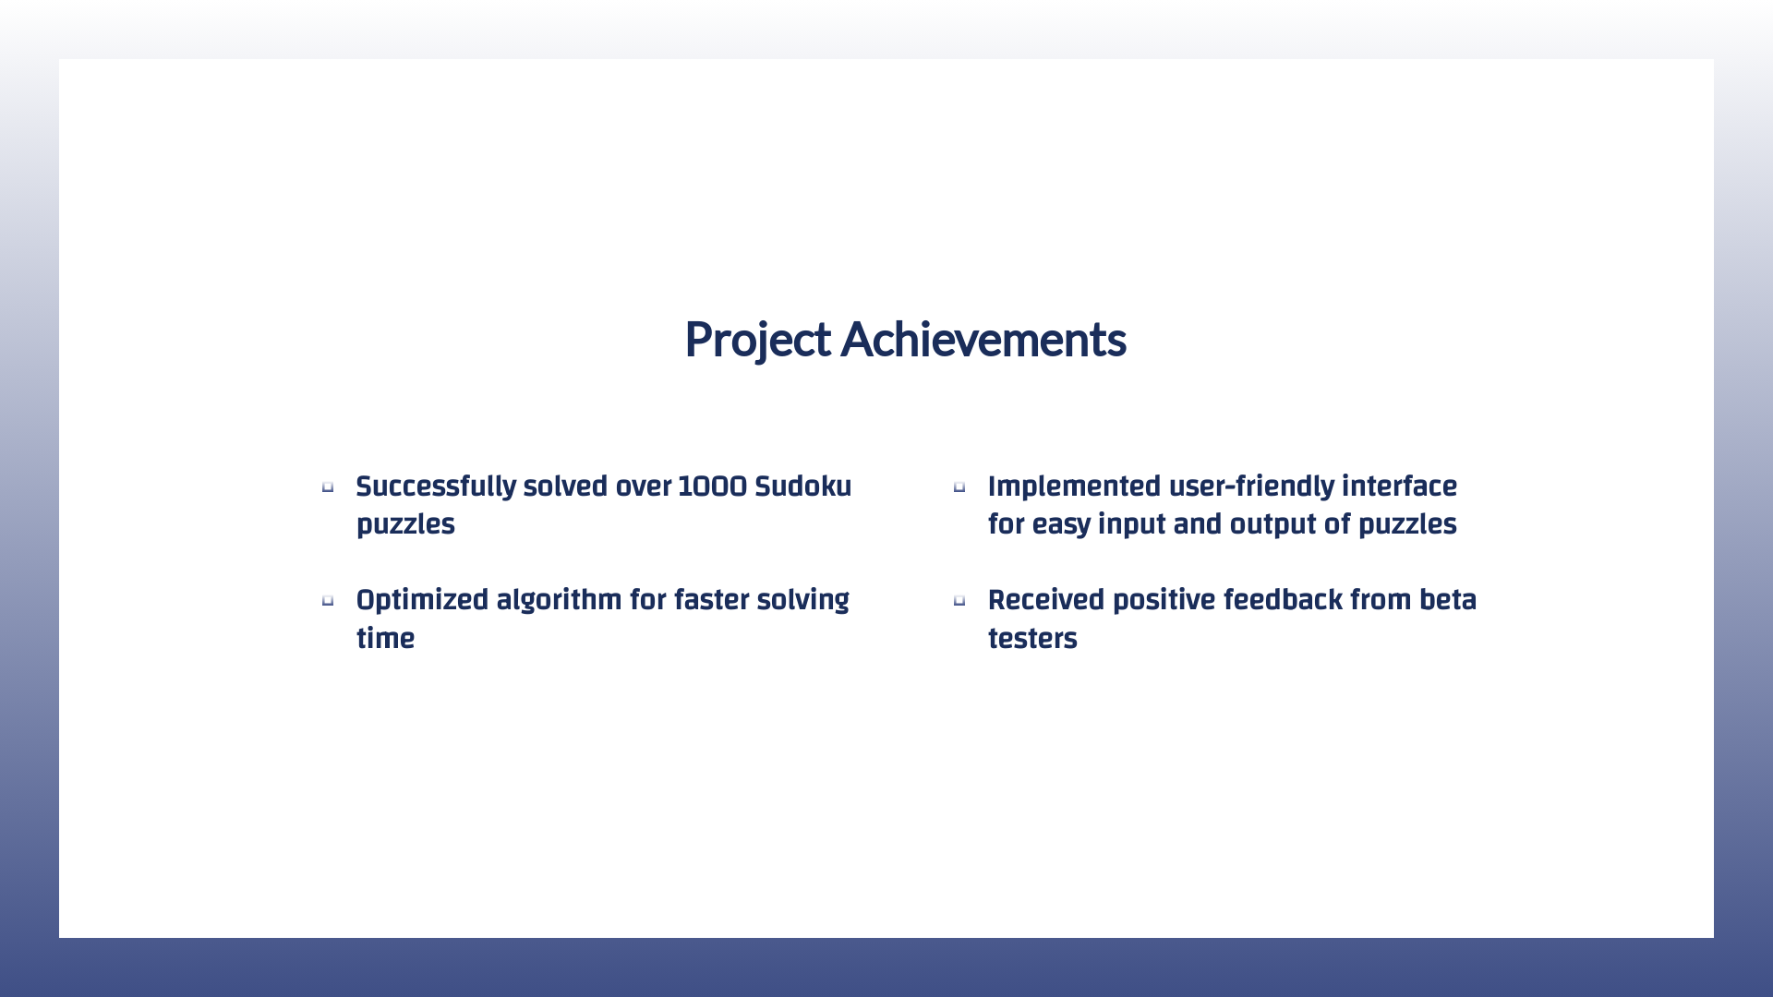

Slide 13
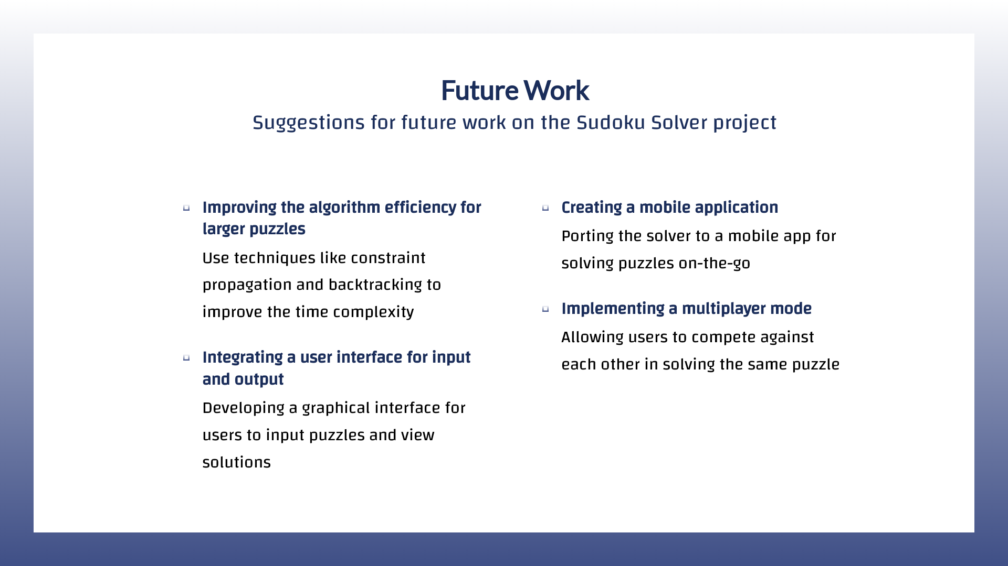

Slide 14
